Slide 1

SMILE AND FROWN DETECTION
CHANDRASHEKARAPURAM, ADITHYA SREENATH –A20402135
ALEEM, ALISHA ANJUM – A20379905

Slide 2
About Smile & Frown Detection
A Program that automatically detects Smile and Frown in live VideoCapture
Using Haar Feature-based cascade classifier

Slide 3
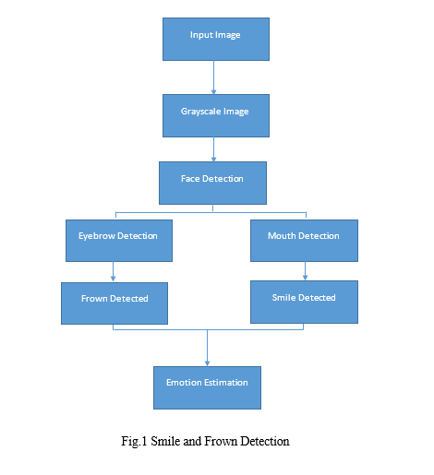

Slide 4
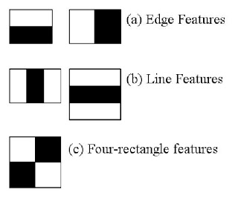
Face detection
Train Classifiers using Positive Images(Faces) and Negative Images(Without Faces)
Extract Features from it using below Haar features

Slide 5
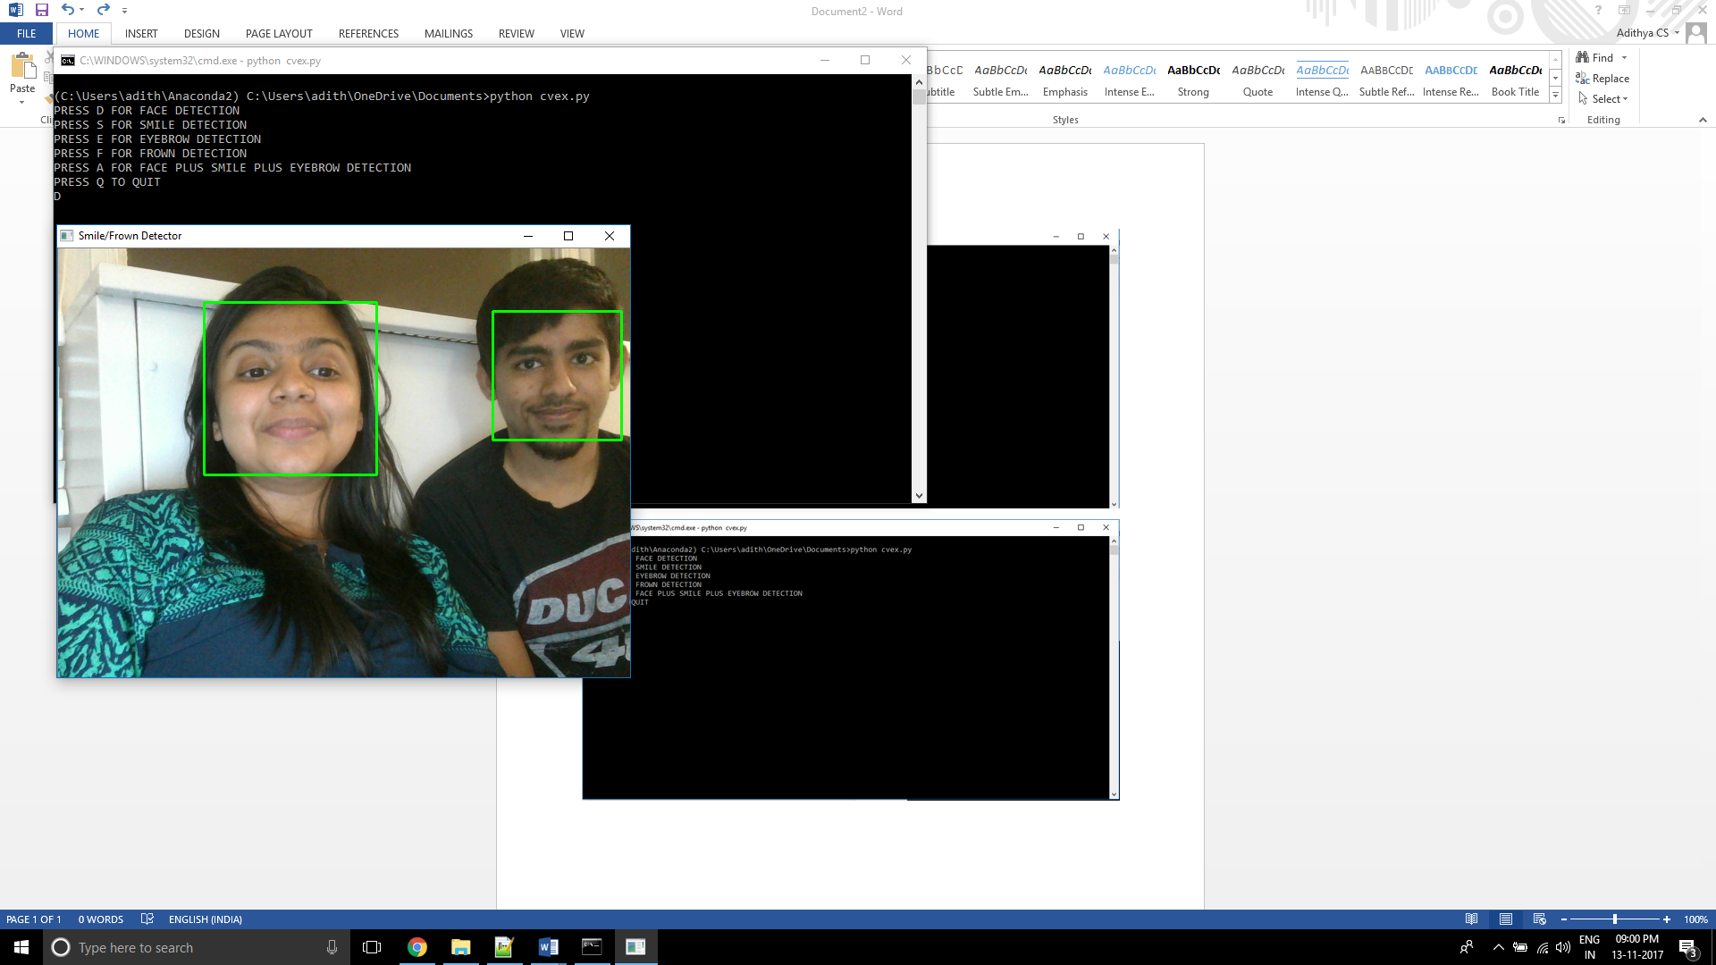

Slide 6
Smile detection
Training Haar Mouth-based Cascade Classifier
Positive Image
Images containing Smiles that we want to recognize
Negative Image
Images containing no smiles
Gathering the data
Negative.txt
a text file containing the name of every negative image sample
Positive.vec
A *.vec file containing positive image samples in binary image format
opencv_createsamples -info positive.txt -w 50 -h 50 -vec pos-samples.vec

Slide 7
Cascade Training
opencv_traincascade -data smile_cascade -vec pos-samples.vec -bg negative.txt -npos 50 -nneg 100 -nstages 17 -nsplits 2 -nonsym -minhitrate 0.998 -maxfalsealarm 0.5 -mem 1024 -mode ALL -w 50 -h 50
smile_cascade.xml (Haarcascade_smile file)

Slide 8
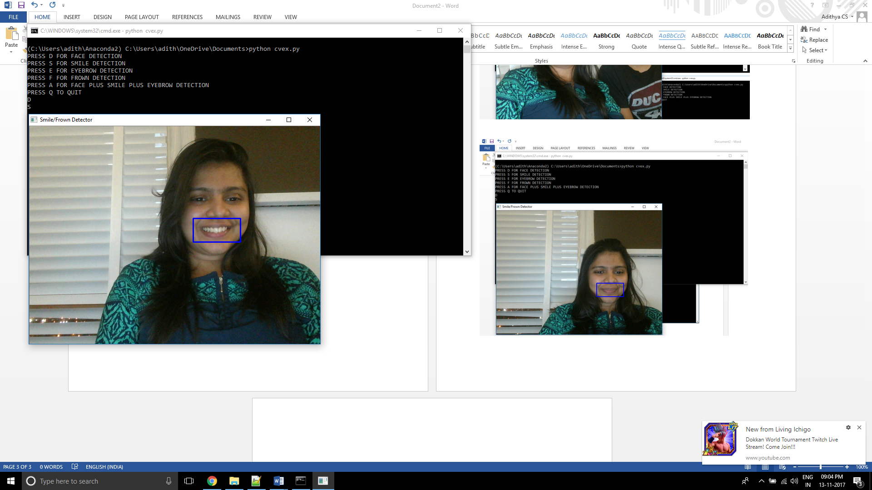
Detecting smile

Slide 9
Frown Detection
Eye Detection
Estimation of eyebrows based on Haarcascade_Eye.xml classifier
Detection of eyebrow and based on presence of no smiles on the face, Frown is detected

Slide 10
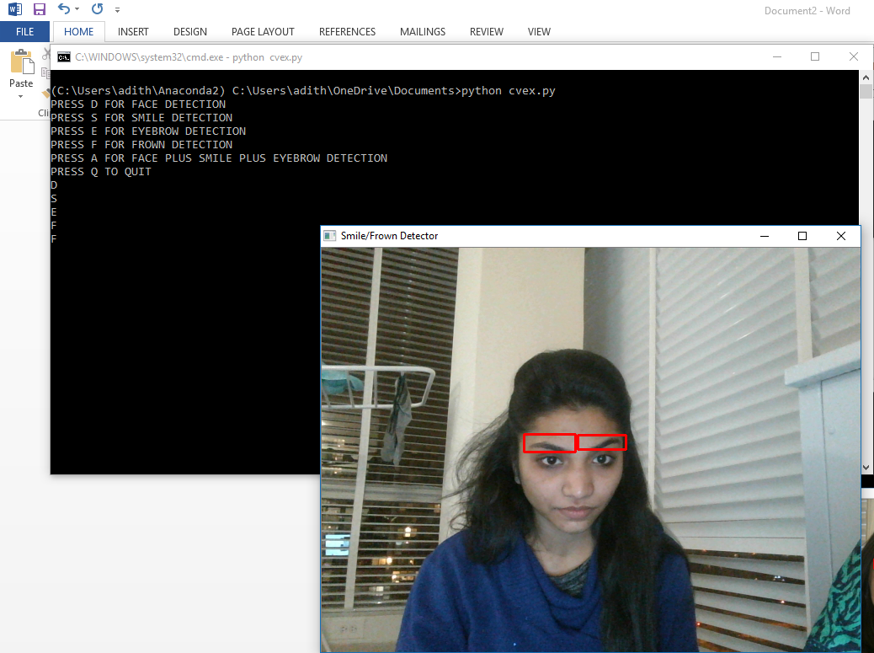
Detecting frown

Slide 11
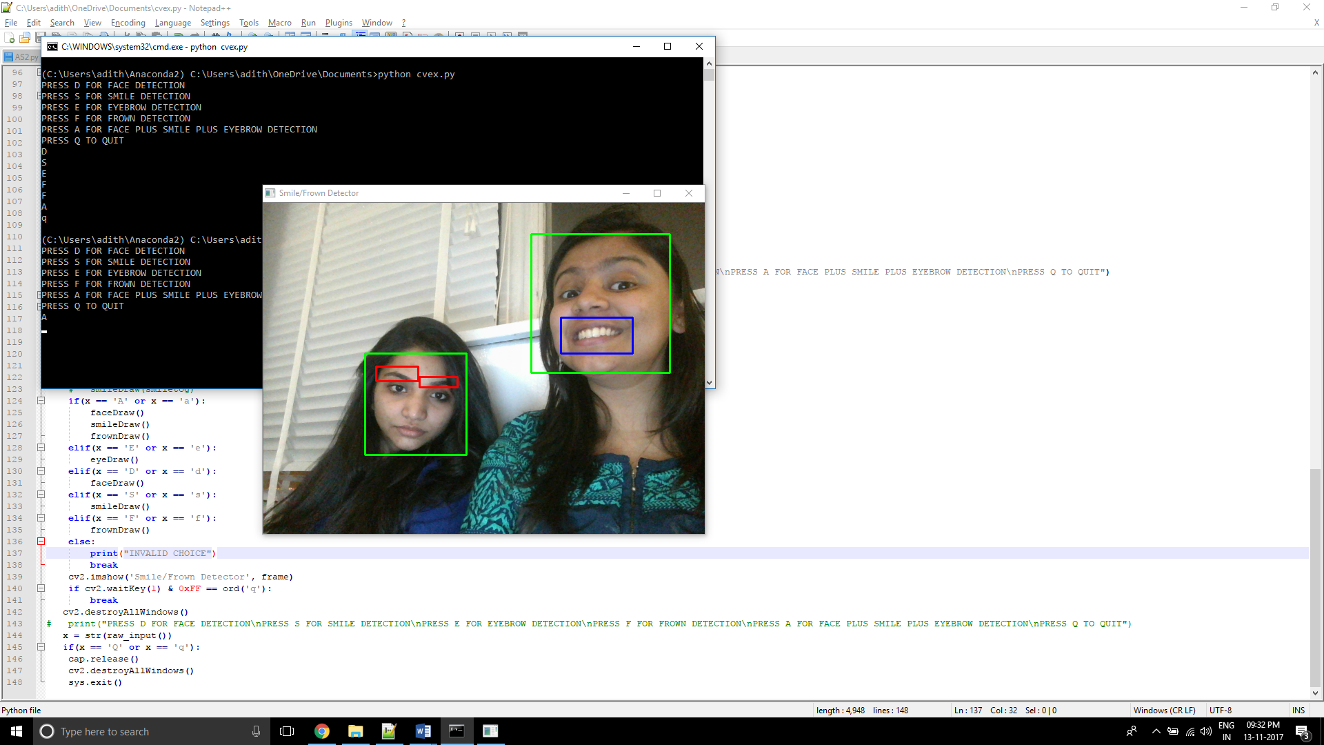
Detecting Smile & Frown

Slide 12
Future Enhancements
A better Haar-cascade can be developed by using a large database of images to improve the efficiency of detection.
A separate classifier can be developed to train images for any emotion. For example: Anger, Surprise, Winking, etc can be detected.
GUI can be implemented

Slide 13
THANK YOU!

